Slide 1





Water Quality Prediction
AICTE Student ID: STU6721aa97a4a8c1730259607 AICTE Internship ID: INTERNSHIP_1746416864681834e0e35d8

Slide 2
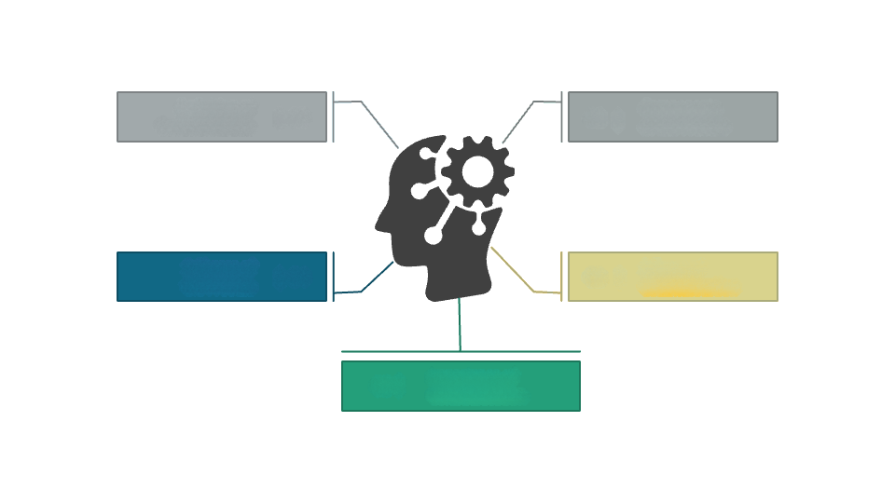


Learning Objectives
🧠
Data Handling
Feature Engineering
Collected, cleaned, and preprocessed real-world water quality data
Managed missing values and encoded station IDs
GOAL
Multi-Output Learning
Model Building
Predicted multiple pollutants using supervised regression
Used Random Forest with MultiOutputRegressor for robust resultst
Model Evaluation
03 |
Validated with MSE and R² for performance accuracy
Source :
www.freepik.com/

Slide 3

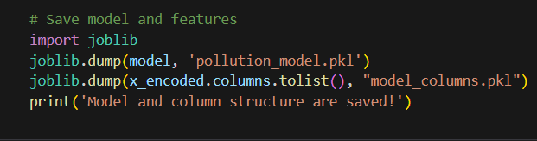

T
ools
VS Code
import joblib
import streamlit as st
import pickle
🖥️Visual Studio Code
💾 joblib
🌐 Streamlit
📦 pickle
The primary code editor for writing, debugging, and managing the project
Used to save and reload trained machine learning models efficiently
Framework used to create an interactive web application for real-time pollutant prediction
For serializing Python objects, enabling model persistence across sessions

Slide 4

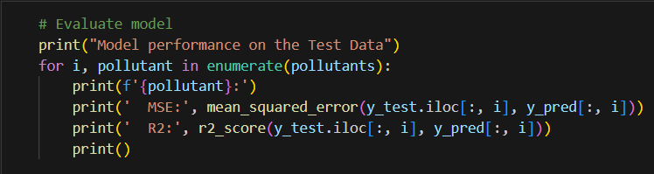

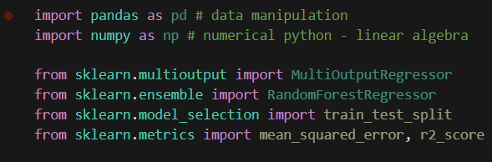

Python
Technologies
scikit-learn
Core programming language used for data processing, model training, and deployment
Machine learning library used to implement the regression model and perform model evaluation
MSE & R² Score
Pandas & NumPy
RandomForestRegressor with
MultiOutputRegressor
Libraries used for data preprocessing, handling missing values, and performing numerical operations
Standard regression metrics used to evaluate and validate model performance
Ensemble learning technique applied for predicting multiple pollutant levels simultaneously

Slide 5


Methodology
Data Collection & Understanding
Collected real-world water quality datasets containing pollutant concentrations and associated parameters like Station ID and Year.
Model Building
Implemented a MultiOutputRegressor wrapped around a RandomForestRegressor to predict multiple pollutant levels simultaneously.
Data Preprocessing
Handled missing values, normalized numerical features, and encoded categorical variables (like Station ID) using one-hot encoding to make the data model-ready.
Model Training & Evaluation
Trained the model on historical data and evaluated its performance using Mean Squared Error (MSE) and R² Score to measure accuracy and reliability.
Model Deployment
Deployed the trained model in a Streamlit web application where users can input the year and station ID to view predicted pollutant levels in a tabular format.
Feature Selection & Engineering
Selected relevant input features (e.g., year, station ID) and target pollutants (O₂, NO₃, NO₂, SO₄, PO₄, CL) for multi-target prediction.

Slide 6
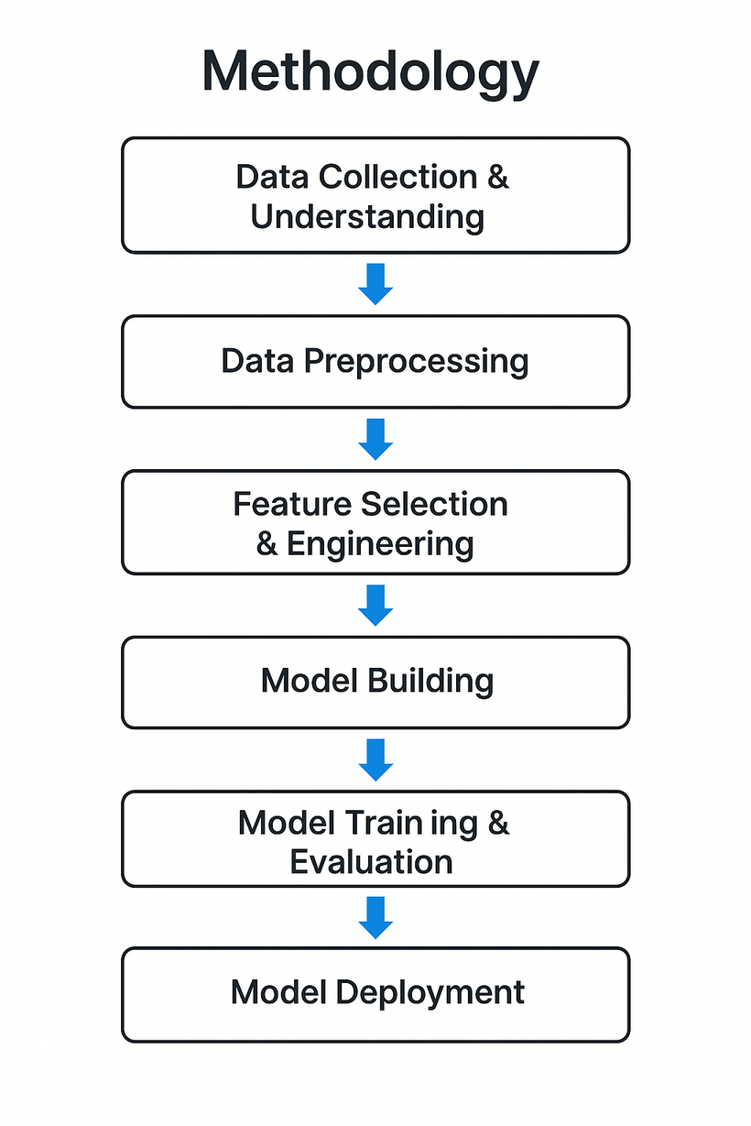
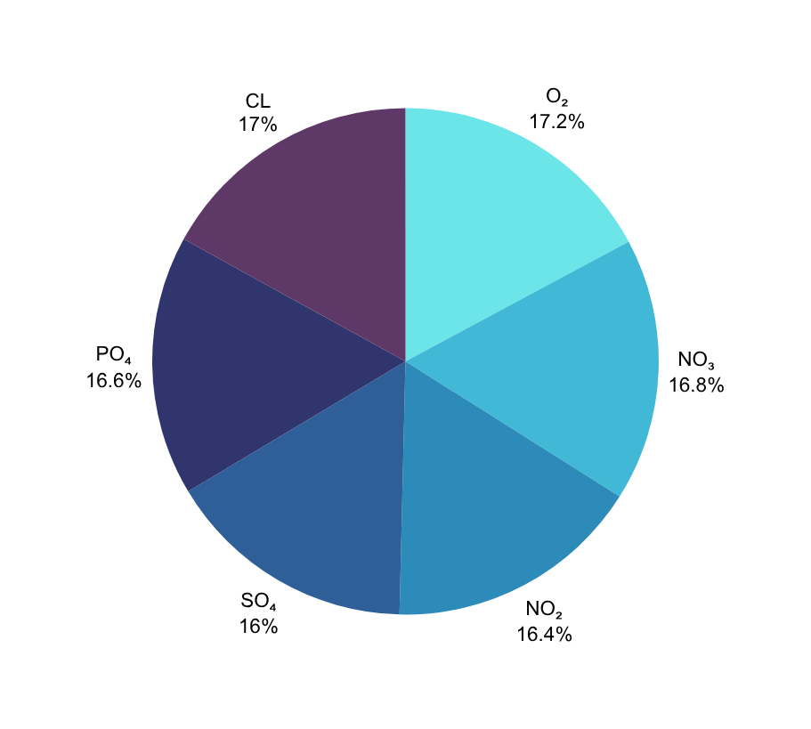
Pollutant-Wise Prediction Accuracy

Slide 7
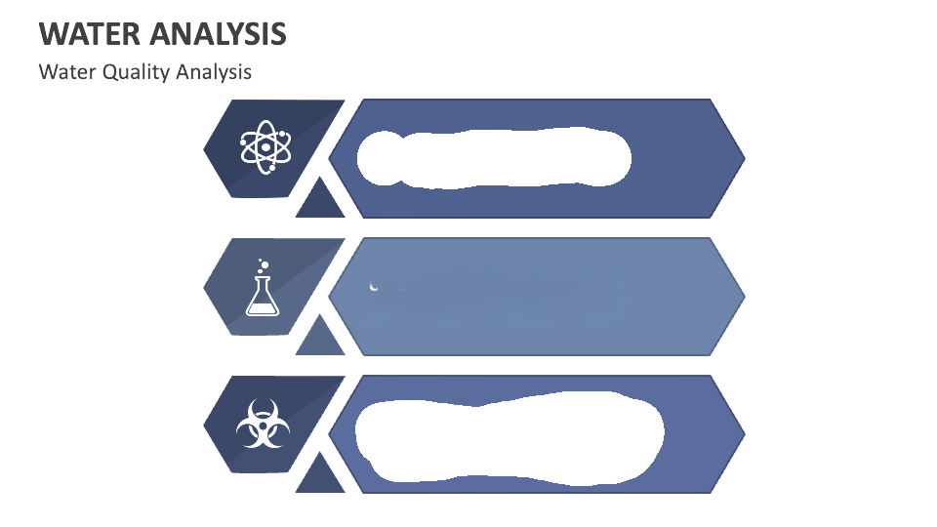
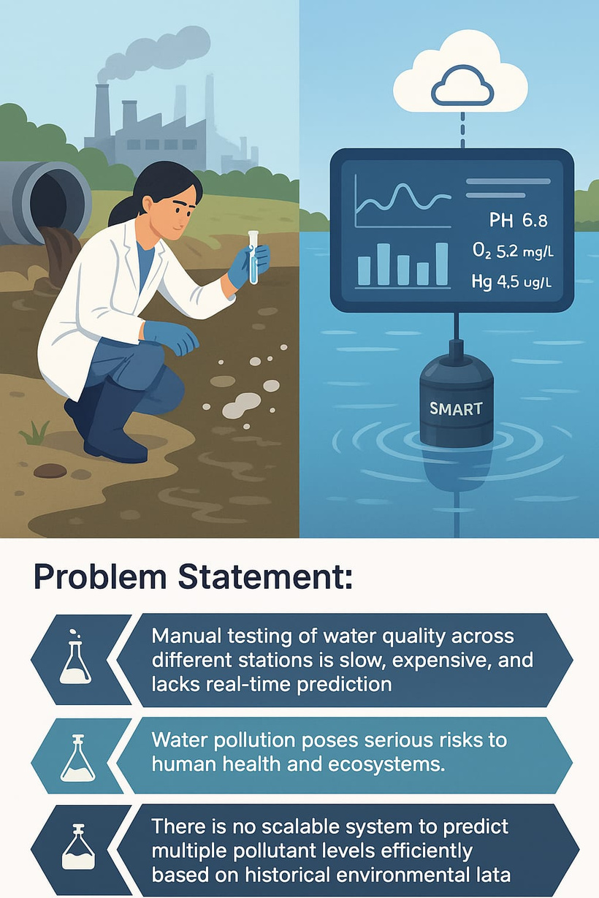
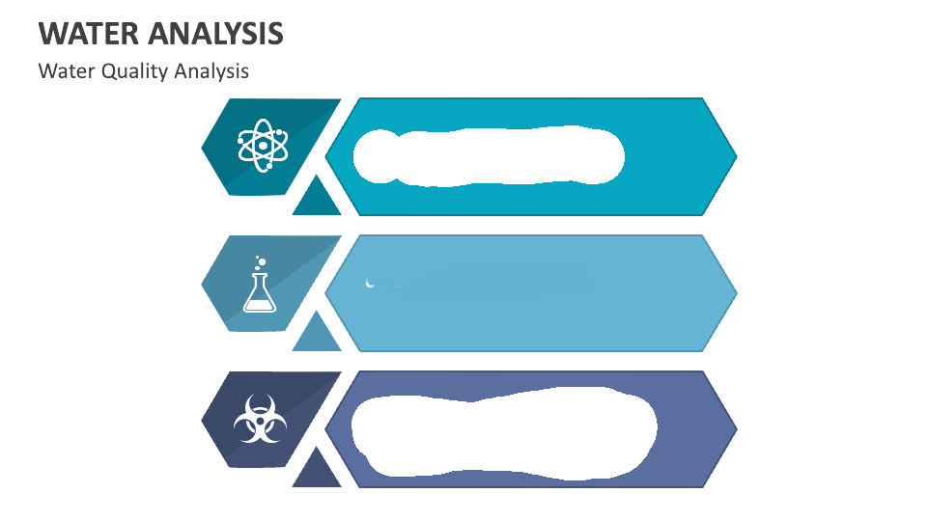
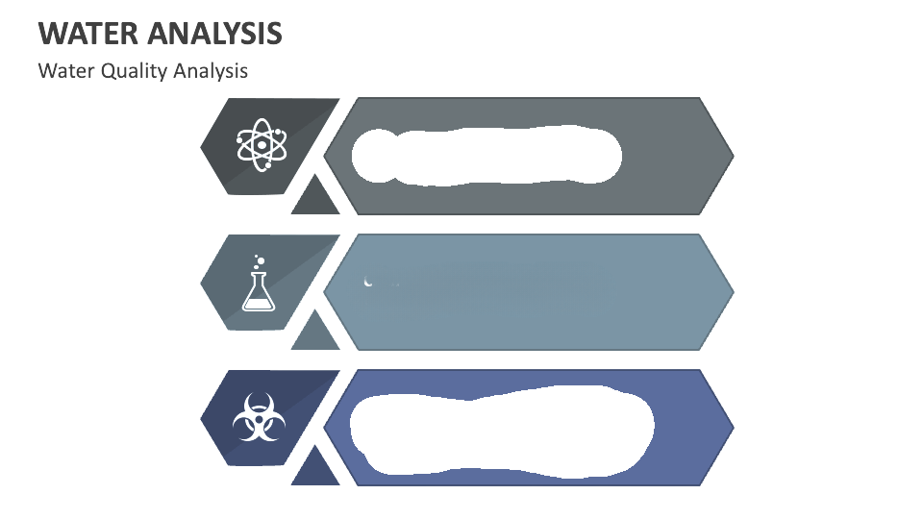
Problem Statement:
Manual testing of water quality across different stations is slow, expensive, and lacks real-time prediction.
Water pollution poses serious risks to human health and ecosystems.
There is no scalable system to predict multiple pollutant levels efficiently based on historical environmental data.

Slide 8


Solution:
The solution is deployed as an interactive Streamlit web app, allowing users to enter inputs and receive real-time, tabular predictions — making water quality assessment faster, scalable, and more accessible.
By using a MultiOutputRegressor with RandomForest, the model can estimate pollutant concentrations accurately.
(W
This project presents a machine learning–based solution that predicts multiple water pollutant levels (O₂, NO₃, NO₂, SO₄, PO₄, CL) based on the year and station ID.
GITHUB LINK - https://github.com/Tejaswini-ece/AICTE_INTERNSHIP.git

Slide 9
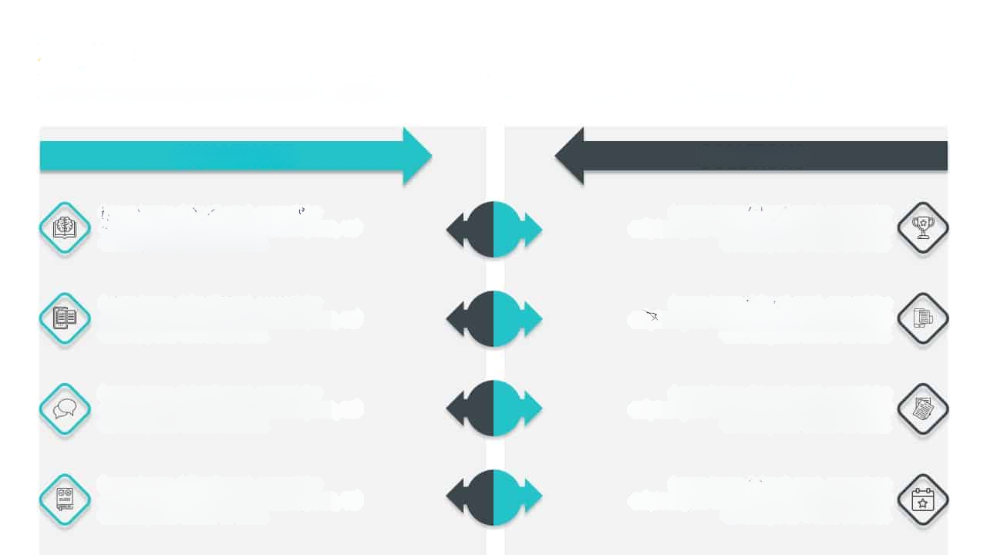
CHALLENGES
SOLUTIONS
Handling missing and inconsistent data
Cleaned and structured dataset for accurate modeling
Encoding station IDs for model compatibility
Applied one-hot encoding to prepare input features
Avoiding overfitting and improving generalization
Achieved reliable performance using MSE and R² metrics
Deploying the model in an interactive format
Created a user-friendly Streamlit web app for real-time use

Slide 10
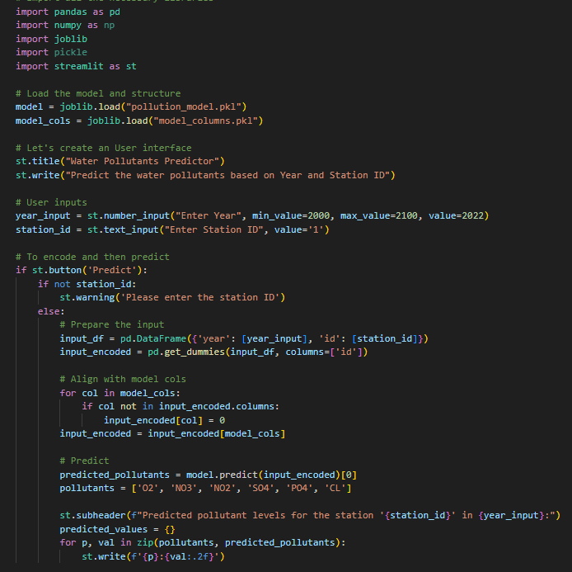
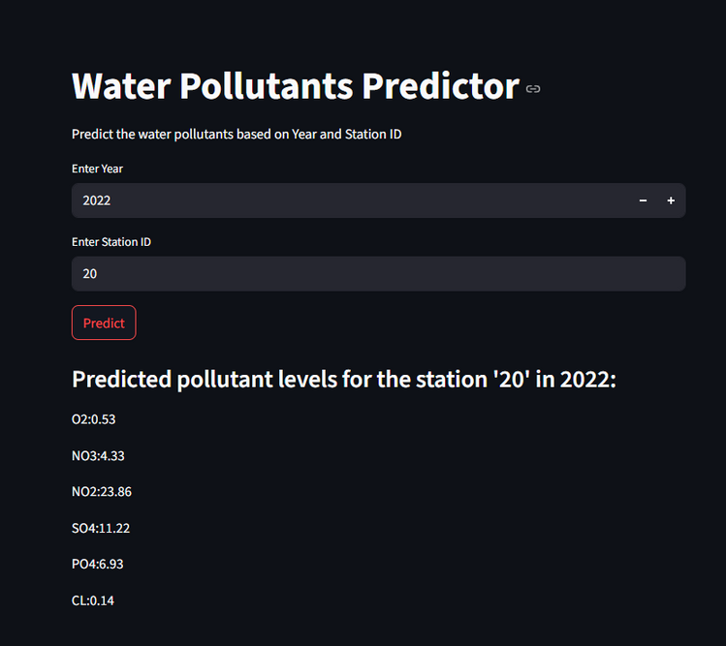
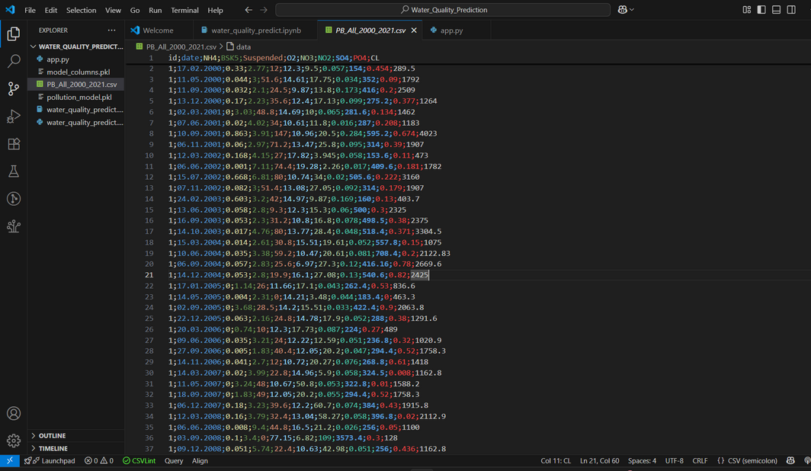
Screenshot of Output:
App Code
Streamlit Output
Dataset

Slide 11
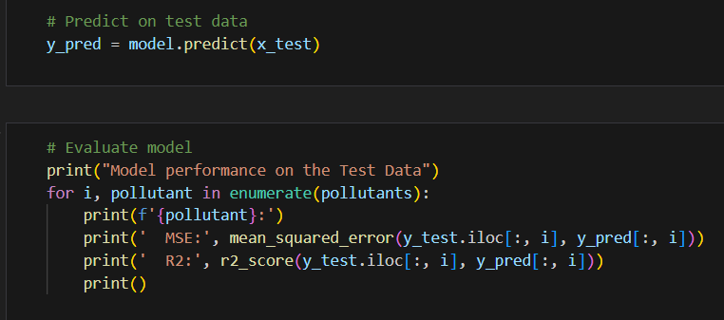
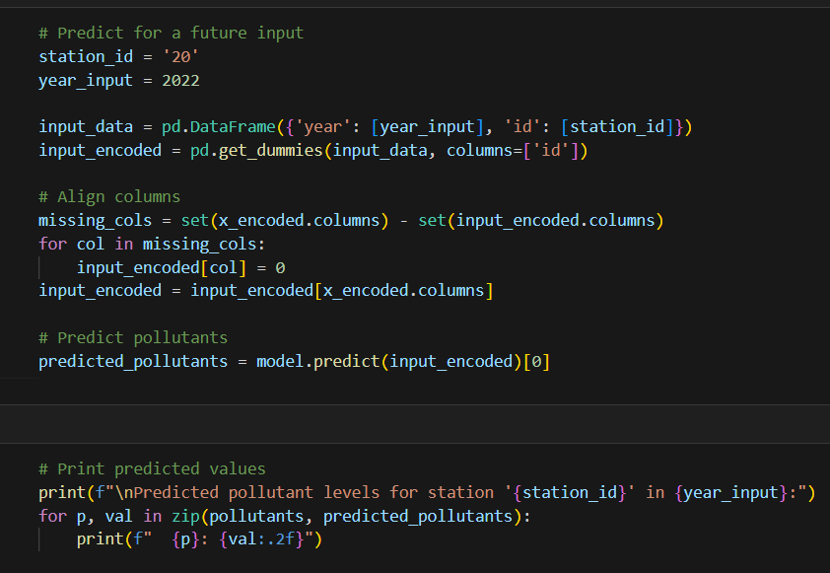
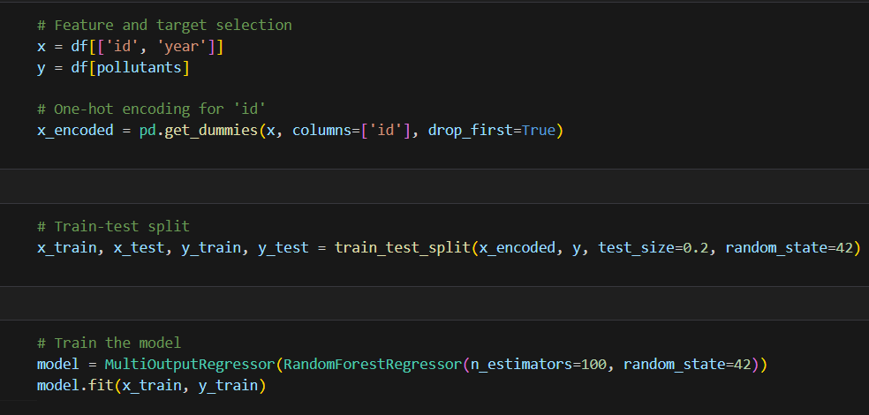
Screenshot of Output:
Prediction

Slide 12






Future Scope
Percentage-Based Pollutant Analysis
Enhance the model output by showing pollutant levels as a
percentage of their permissible limits for better interpretability.
Drinking Water Safety Indicator
Integrate a clear indicator (Safe / Not Safe for Drinking) based on WHO or CPCB standards, helping users easily understand water safety.
Improved Tabular Results
Display a more detailed output table with pollutant name, predicted value, permissible limit, percentage, and safety status for each parameter.
Historical Comparison Feature
Allow users to compare current predictions with previous years’ data to observe water quality trends over time.
Live Data Integration
In the future, connect the system with IoT sensors or public APIs for real-time water quality data and prediction.

Slide 13


Conclusion:
🚀 Built an accurate multi-output prediction model using RandomForest to estimate multiple water pollutant levels simultaneously.
🌐 Developed a user-friendly Streamlit web app enabling real-time, tabular pollutant predictions based on year and station ID.
📈 Achieved reliable performance using MSE and R² metrics, showcasing the potential of machine learning for environmental monitoring.
Elli
GITHUB LINK - https://github.com/Tejaswini-ece/AICTE_INTERNSHIP.git

